Slide 1
Slide 7
Slide 6
Data Analysis on Restaurants in Zomato
Slide 5
Using R and Statistical measures
Slide 4
Slide 3
Slide 2
By C Aishwarya
Roll no- 8
CB.SC.P2ASD20008
Amrita Vishwa Vidyapeetham, Coimbatore
Slide 1

Slide 2




Slide 7
Introduction
Slide 6
Aim: Data analysis on restaurants in Zomato for the city, New Delhi
Slide 5
New Delhi
Zomato
Also known as Dilli, Capital of India and an administrative district of NCT Delhi. Often considered as hub for international trade.
An Indian restaurant search and discovery service founded in 2008 by Deepinder Goyal and Pankaj Chaddah. Currently operating in 24 countries.
Slide 4
Slide 3
Cosmopolitian City
Unique food culture
Due to multi-ethnic cultural presence of all the foreign embassies and high commissions in the city.
Restaurants from all over the world can be found in Delhi, with various kind of cuisines.
Slide 2
Slide 1

Slide 3
Slide 7
Contents & Objective
To gain insights of restaurants in Delhi and the factors that influence it.
Slide 6
To analyse dataset imported
To get distribution of each variables
Compute correlation between variables
Get graphical inference
Slide 5
Data
Pre-Processing
Slide 4
Visualising
Slide 3
Analyzing
Slide 2
Sorting and deleting unwanted information’s.
Plotting Histograms, Pie Charts and Bar graphs to understand the dataset.
Slide 1

Slide 4
Loading & Preprocessing of Data in R Language
Slide 6
The dataset is taken from Kaggle,courtesy of Himanshu Poddar. Click here
Load the Data:
zomato <- read.csv("C:/Users/abhij/Downloads/zomato.csv (1)/zomato.csv")
Selecting restuarants from City- New Delhi and Gurgaon:
DelhiZomato<-zomato[zomato$City %in% c("New Delhi","Gurgaon"),]
Selecting specific places from locality:
mydataset<-DelhiZomato[DelhiZomato$Locality %in% c("Paschim Vihar, New Delhi","Mayur Vihar Phase 1","Malviya Nagar, New Delhi","Krishna Nagar, New Delhi","Subhash Nagar","Sohna Road","Chanakyapuri","Rajinder Nagar","Moments Mall, Kirti Nagar, New Delhi","Sector 56","Alaknanda","Kalkaji,New Delhi","Sector 45","Sector 14","Sector 29","Ambience Mall", "Vasant Kunj","Aerocity","Barakhamba Road, New Delhi","Chanakyapuri, New Delhi","Chandni Chowk, New Delhi","Chittaranjan Park, New Delhi","Connaught Place, New Delhi","Daryaganj, New Delhi","Defence Colony, New Delhi","Delhi University-GTB Nagar, New Delhi","Greater Kailash (GK) 1, New Delhi","Hauz Khas Village","Jail Road","Janakpuri","Khan Market","Lado Sarai","Lajpat Nagar 1","Lodhi Colony","R K Puram","Shalimar Bagh","Vikaspuri","Cyber Hub, DLF Cyber City","DLF Mega Mall, DLF Phase 1","Uttam Nagar"),]
Slide 3
Slide 5
Slide 4

Slide 5
Cleaning and deleting unwanted columns
mydataset1<-mydataset[,-which(names(mydataset)%in% c("Cuisines","Restaurant.ID","Country.Code","Address","Locality.Verbose","Longitude","Latitude","Currency","Is.delivering.now","Switch.to.order.menu","Price.range","Rating.color"))]
Removing unrated restaurants
mydataset1<-mydataset1[mydataset1$Aggregate.rating>0,]
Packages Required:
psych
ggplot2
Highcharter
Dplyr
Tidyverse
tydr
Slide 6
Slide 5
Slide 4

Slide 6
Slide 9
Attributes of Dataset
Dataset contains the following features.
Slide 8
Restaurant.Name,
City,
Locality
1.Restaurant.Name:
2.City:
3.Locality:
4.Aggregate.rating:
5.Has.Table.booking:
6.Has.Online.delivery:
7.Rating.text:
8.Votes:
Has.Table.booking,
Has.Online.delivery
Slide 7
Slide 6
Slide 5
Slide 4
Rating.text,
Votes
Aggregate.rating
Slide 3

Slide 7
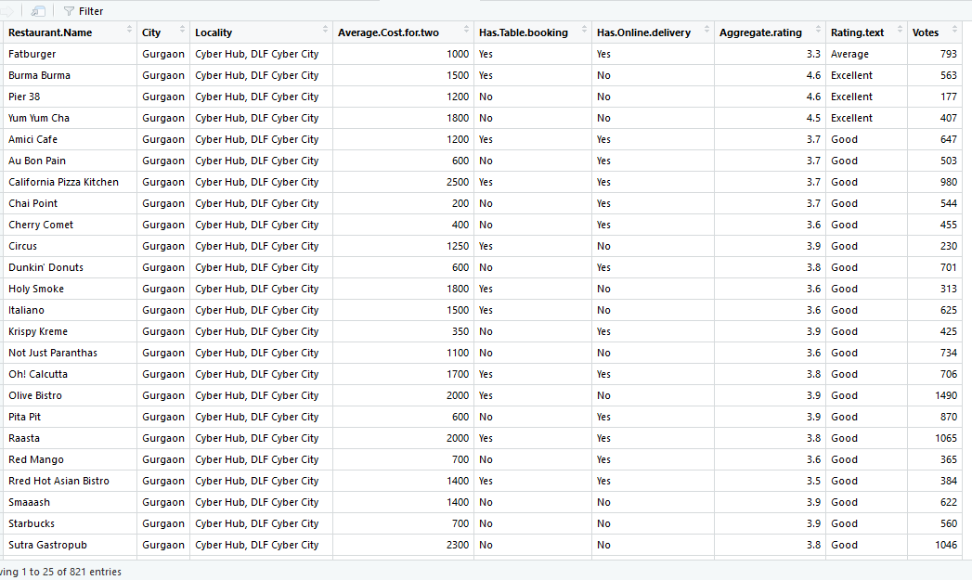
Data
View of mydata1
After cleansing and processing
Slide 4

Slide 8
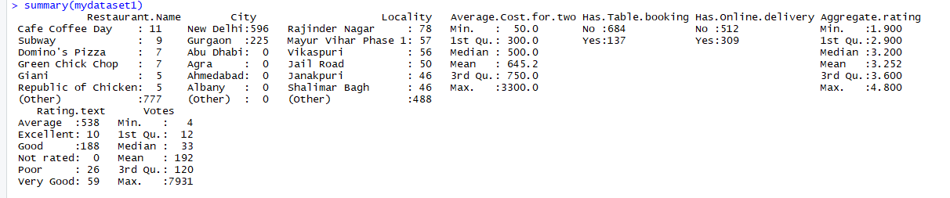

Slide 9
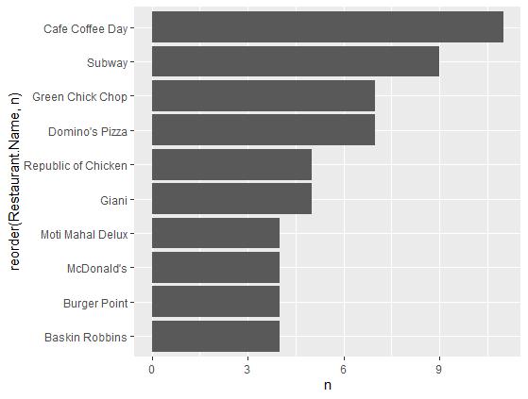
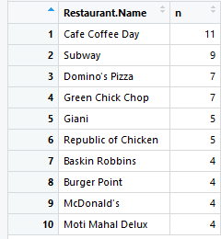
Maximum Number of Restaurant Outlets in New Delhi
The graph depicts the top 10 restaurants with maximum outlets in New Delhi.:
We can see that
1.Cafe Coffee Day has the highest outlets in Delhi with 11 in number.
2.Subway - 2nd highest -9 outlets
3.Green chick chop -3rd highest-7 outlets
Slide 7
Slide 6
Slide 5

Slide 10

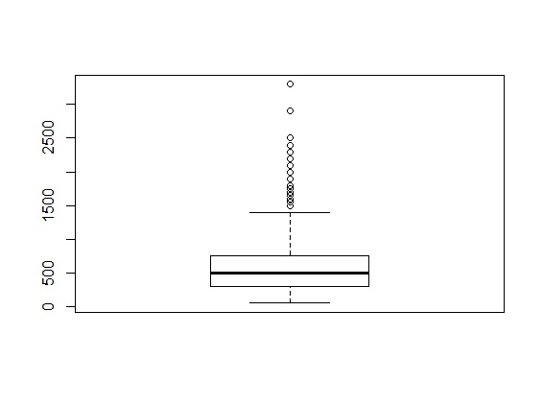
Average Cost of Two People in Restaurant
Slide 7
→ The coefficient of skewness 1.77 is greater than 0, hence we can say that the data is positively skewed.
→ Also, The coefficient of kurtosis 2.99 is less than 3, which implies that the distribution is platykurtic.
→ The minimum average cost of two people in a restaurant is Rs.50 and the maximum cost is Rs.3300

Slide 11
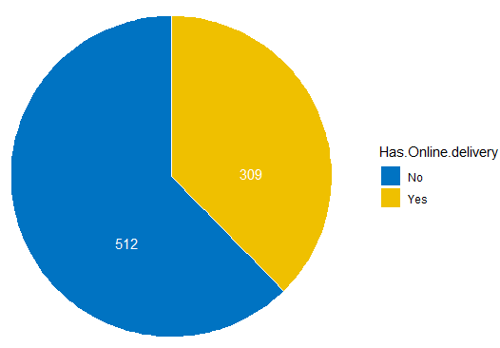
Online Delivery
Slide 9
Slide 8

Slide 12
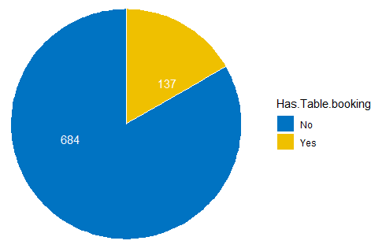
Slide 10
Online Table Booking
Slide 9

Slide 13

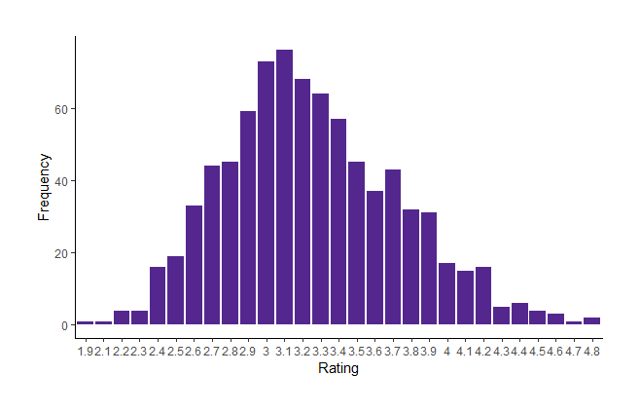
Slide 11
RATING
Rating seems to have normal distribution with skewness approx. 0 (I.e 0.39) and kurtosis also being approx. 0 (I.e -0.08) , we can say its almost symmetrical
Slide 10

Slide 14
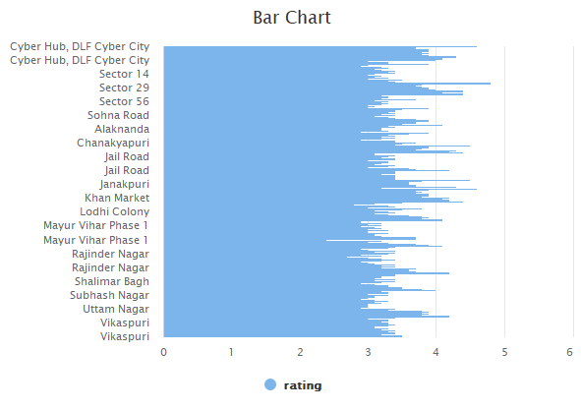
Rating Vs Locality
Slide 11
Slide 12
→Sector 14 has the highest rating with 4.9
→Mayur Vihar phase 1 with lowest rating as 2.4

Slide 15
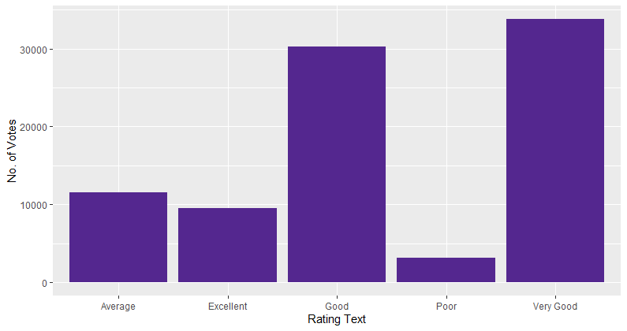
Comparison of Restaurants Votes and Rating
Slide 13
Slide 12
Slide 4
→ Restaurants with rating comments as “Very Good” has higher votes and comments as “Poor” has lower votes
Slide 11

Slide 16
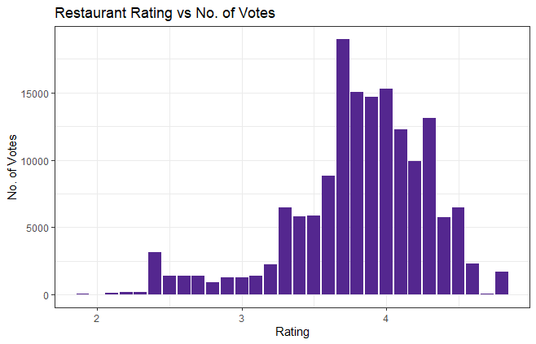
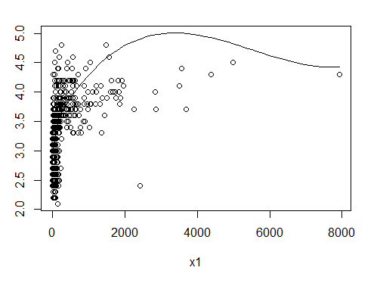
Restaurant Vs Votes
Slide 14
Slide 15
Slide 6
As correlation between Rating and no of votes is positive( I.e 0.4265) , it has weak uphill(positive) linear relationship.
Slide 13
cor(mydataset1$Votes,mydataset1$Aggregate.rating) [1] 0.426593

Slide 17
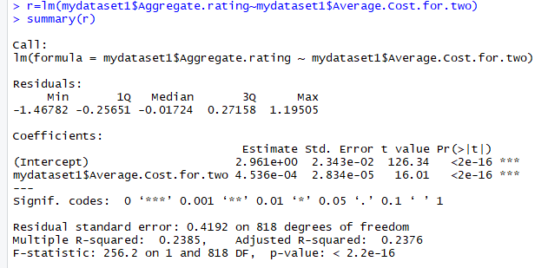

Slide 16
Aggregate Rating ~ Average Cost for two
In this,
Y~X
Y=Aggregate Rating
X=Average cost for two
a0 =Intercept Value :2.961e+00
a1= 4.536e-04
Y=2.961e+00 +4.536e-04X
R squared value=0.2385
(Model is a bad fit.)
P-value: 2.2e-16<0.05
(Aggregate rating attribute contributes a significant relationship with Average Cost for two
Slide 15

Slide 18
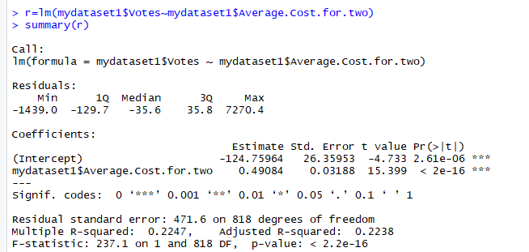
Votes ~ Average Cost for two
Slide 16
In this,
Y~X
Y=Votes
X=Average cost for two
a0 =Intercept Value :-124.75964
a1=0.49084
Y=:-124.75964+00 +0.49084X
R squared value=0.2247
(Model is a bad fit.)
P-value: 2.2e-16<0.05
(Votes attribute also contributes a significant relationship with Average Cost for two.
Slide 15

Slide 19
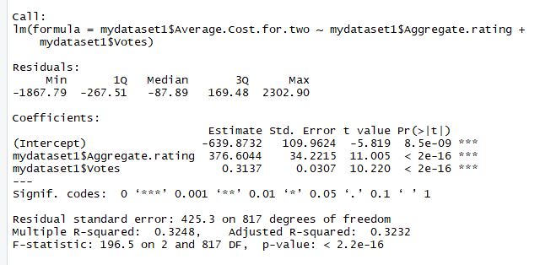
Average Cost for two~Aggragate.rating+Votes
Slide 18
In this,
Y~X1+X2
Y=Average Cost for two
X1=Aggregate rating
X2=Votes
a0 =Intercept Value :-639.8732
a1=376.6044
a2= 0.3137
Y=: -639.8732+376.6044X1
+0.3137X2
R squared value=0.3248
(Model is a bad fit.)
P-value: 2.2e-16<0.05
(Average Cost for two attribute contributes a significant relationship with both Aggregate rating and Votes.
Slide 17

Slide 20
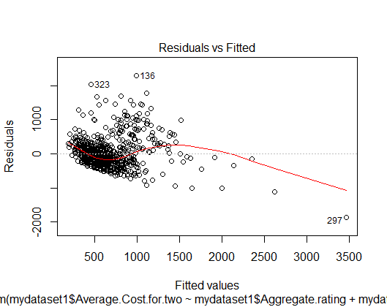
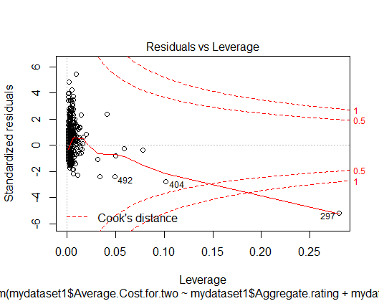
Residuals
Slide 19
Residual vs Fitted : This tells us that there is no distinct pattern and the red line is going towards negative, which tell us that their linear relationship is not good.
Residual vs Leverage: As there are no points which are outside the Cook’s distance, we can say there are no points that has high influence on the model.

Slide 21
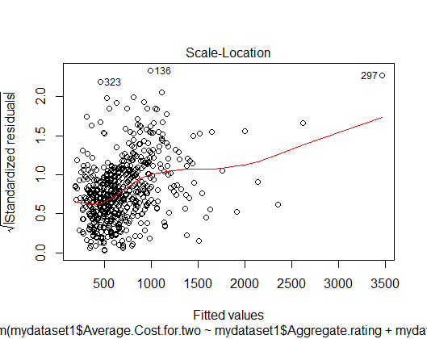
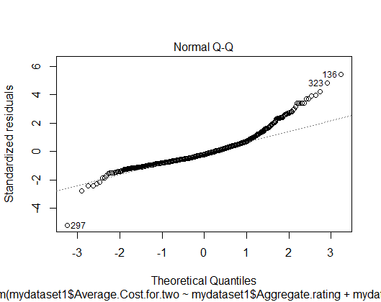
Slide 20
Slide 19
Scale-Location : This graphs shows that the residuals have variance concentrated only around the beginning of line and there are fewer points at the end of the line,so slightly variance there.
Normal Q-Q(quantile-quantile) :shows pretty good alignment to the line with a few points at the top slightly offset, an indication that they are normally distributed.

Slide 22
Slide 21
Slide 20
Slide 19
Thank you
Slide 18
Slide 17
Slide 16
Slide 15

